Slide 1
Workshop on Iptables
by Tufail Mustafa AM-IT Fast NUCES Peshawar

Slide 2
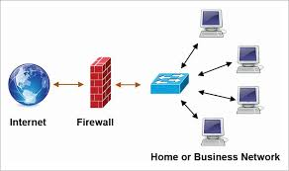
What is Firewall…
A firewall is a network security device that monitors incoming and outgoing network traffic and decides whether to allow or block specific traffic based on a defined set of security rules.
Firewalls have been a first line of defense in network security.
They establish a barrier between secured and controlled internal networks that can be trusted and untrusted outside networks, such as the Internet.

Slide 3

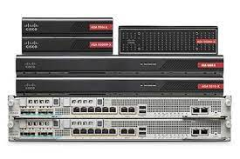

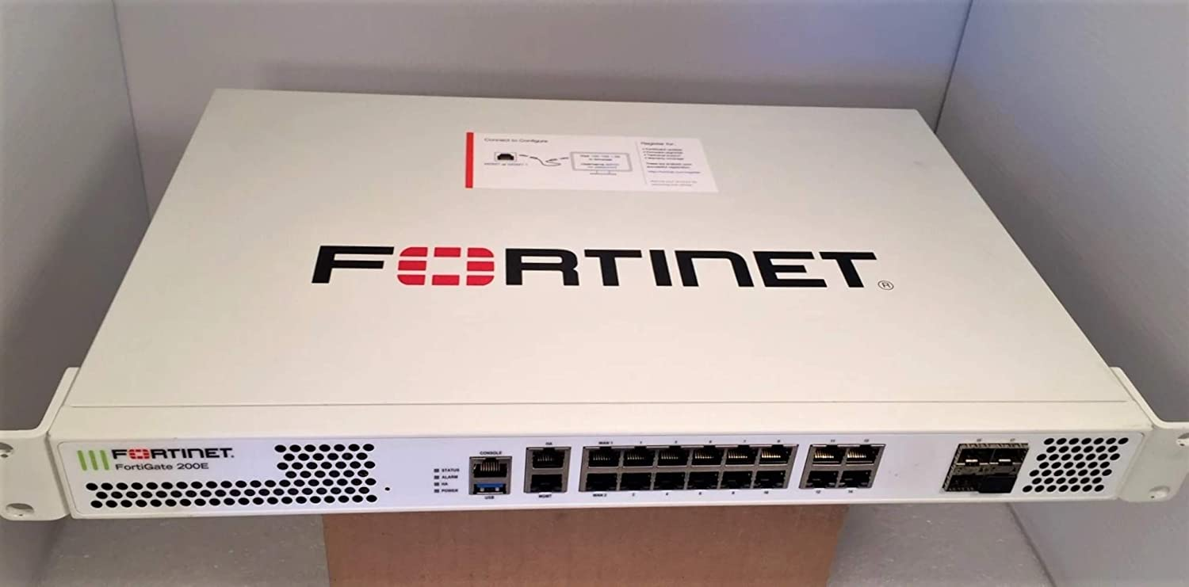
firewall Hardware Based

Slide 4
A firewall can be Software’s Based (Appliance)
IP Cop Firewall
Pf Sense
IP Fire
Smooth Wall
Clear OS

Slide 5
Types of Firewalls
Packet filtering A small amount of data is analyzed and distributed according to the filter’s standards.
Proxy service Network security system that protects while filtering messages at the application layer.
Stateful inspection Dynamic packet filtering that monitors active connections to determine which network packets to allow through the Firewall.
Next Generation Firewall (NGFW) Deep packet inspection Firewall with application-level inspection.
Cloud base firewall
Cloud Firewalls are software-based, cloud deployed network devices, built to stop or mitigate
unwanted access to private networks.

Slide 6
Iptables
Iptables is an extremely flexible firewall utility built for Linux operating systems.
iptables is a command-line firewall utility that uses policy chains to allow or block traffic.
Implemented as Net filter modules, iptables is a user-space utility program that allows a system administrator to configure the IP packet filter rules of the Linux kernel firewall.
The filters are organized into tables containing chains of rules which govern how to treat network traffic packets.
Net filter is the firewall framework on Linux.
On a high-level iptables might contain multiple tables
.Tables might contain multiple chains.
Chains can be built-in or user-defined.
Chains might contain multiple rules.
Rules are defined for the packets.
So, the structure is: iptables -> Tables -> Chains -> Rules. This is defined in the
iptables almost always comes pre-installed on any Linux distribution.

Slide 7
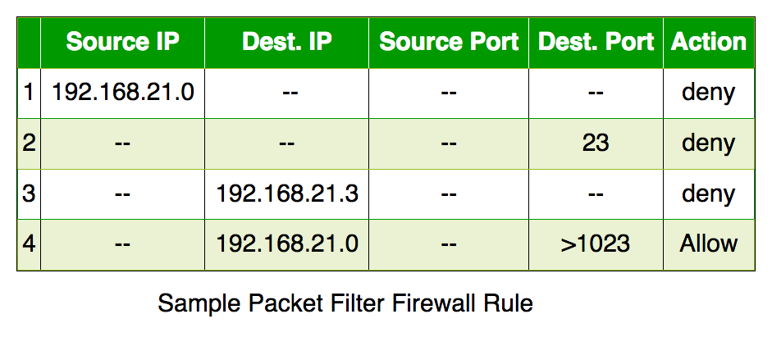
Iptables Rule Structure

Slide 8
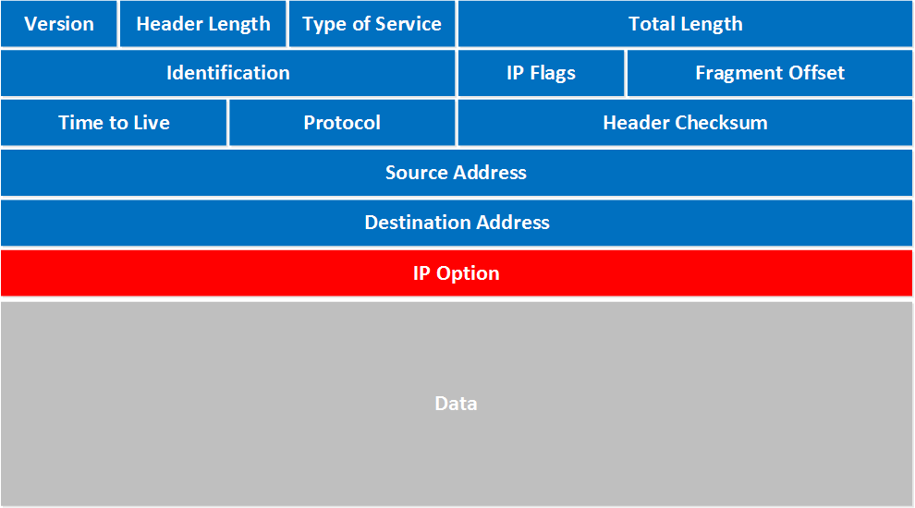
IP Header

Slide 9
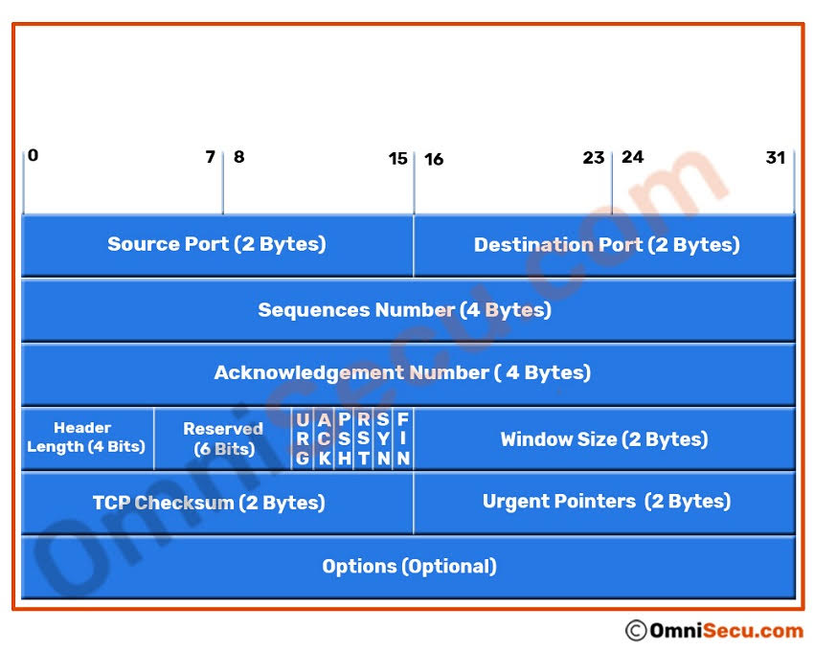
TCP Header

Slide 10
TABLES & CHAINS
A table is a collection of chains that serves a particular function. The 3 main tables in iptables are the Filter, NAT, and Mangle tables.
The Filter Table is used to control the flow of packets in and out of a system.
The NAT Table is used to redirect connections to other interfaces on the network.
The Mangle Table is used to modify packet headers.

Slide 11
NAT Table
Ip table’s NAT table has the following built-in chains.
PREROUTING chain – Alters packets before routing. i.e., Packet translation happens immediately after the packet comes to the system (and before routing). This helps to translate the destination IP address of the packets to something that matches the routing on the local server. This is used for DNAT (destination NAT).
POSTROUTING chain – Alters packets after routing. i.e., Packet translation happens when the packets are leaving the system. This helps to translate the source IP address of the packets to something that might match the routing on the destination server. This is used for SNAT (source NAT).
OUTPUT chain – NAT for locally generated packets on the firewall.

Slide 12
Filter Table
Filter is default table for iptables. Iptables’s filter table has the following built-in chains.
INPUT chain – Incoming to firewall. For packets coming to the local server.
OUTPUT chain – Outgoing from firewall. For packets generated locally and going out of the local server.
FORWARD chain – Packet for another NIC on the local server. For packets routed through the local server.

Slide 13
Mangle table
Iptables’s Mangle table is for specialized packet alteration. This alters QOS bits in the TCP header. Mangle table has the following built-in chains.
PREROUTING chain
OUTPUT chain
FORWARD chain
INPUT chain
POSTROUTING chain

Slide 14
IP TABLES RULES
Following are the key points to remember for the iptables rules.
Rules contain a criteria and a target.
Keep in mind that the order of your rules matter.
If the criteria is matched, it goes to the rules specified in the target (or) executes the special values mentioned in the target.
If the criteria is not matached, it moves on to the next rule.
General syntax
Syntax: iptables [options] [chain] -j [target]
Options:
Chains:
Targets:

Slide 15
-t or --table | Specifies the packet matching table. Default table is set to filter if no table is specified.
-I or --insert chain [rule-number] rule | Inserts one or more rule(s) to the in the selected chain as the given rule number. Indexing begins with 1.
-A or --append chain rule-specification | Appends one or more rule(s) to the list of rules to the end of the selected chain.
-L or --list [chain] | Lists all the rules in the selected chain. If no chain is specified all chains are listed.
-D or --delete chain rule-specification | Deletes one or more rule(s) in the selected chain.
-D or --delete chain rule-number | Deletes the specified rule in the selected chain. Indexing begins with 1.
-p or --protocol [!] | The protocol to check (TCP, UDP, icmp, or all). Using the ! argument before the protocol inverts the test.
-s or --source [!] | The source specification. This can be either a network, hostname, or IP address. Using the ! argument before the source inverts the sense of the address.
--destination-port or --dport | The destination port range.
-j or --jump target | This is the target of the rule and specifies what to do in the case of a match.
-m or --match match | Specifies an extension module that tests for a specific property.
-p or --policy chain target | Sets the policy for the chain to the target.
F or --flush [chain] | Flushes the selected chain. If no chain is specified, all chains are flushed. Flushing is akin to deleting all rules one by one.

Slide 16
Target
target | Desciption | Most Common Options
ACCEPT | iptables stops further processing.The packet is handed over to the end application or the operating system for processing | N/A
DROP | iptables stops further processing. The packet is blocked | N/A
LOG | The packet information is sent to the syslog daemon for logging iptables continues processing with the next rule in the table As you can't log and drop at the same time, it is common to have two similar rules in sequence. The first will log the packet, the second will drop it. | --log-prefix "string" Tells iptables to prefix all log messages with a user defined string. Frequently used to tell why the logged packet was dropped
REJECT | Works like the DROP target, but will also return an error message to the host sending the packet that the packet was blocked | --reject-with qualifier The qualifier tells what type of reject message is returned. Qualifiers include: icmp-port-unreachable (default) icmp-net-unreachable icmp-host-unreachable icmp-proto-unreachable icmp-net-prohibited icmp-host-prohibited tcp-reset echo-reply
DNAT | Used to do destination network address translation. ie. rewriting the destination IP address of the packet | --to-destination ipaddress Tells iptables what the destination IP address should be
SNAT | Used to do source network address translation rewriting the source IP address of the packet The source IP address is user defined | --to-source <address>[-<address>][:<port>-<port>] Specifies the source IP address and ports to be used by SNAT.
MASQUERADE | Used to do Source Network Address Translation. By default the source IP address is the same as that used by the firewall's interface | [--to-ports <port>[-<port>]] Specifies the range of source ports to which the original source port can be mapped.

Slide 17
TYPES OF NAT
STATIC
DYNAMIC
PAT

Slide 18
PAT
Also called many to one
Many private Ip are translate to a single IP(public) .
Mostly used
THANK YOU

